Slide 1

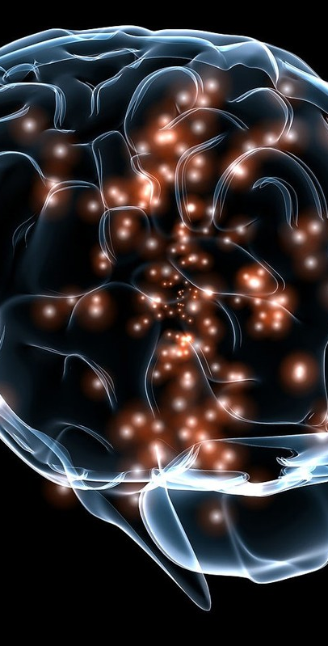
AI Precision for Brain Tumor PREDICTION
Welcome! This presentation will explore our revolutionary AI-powered MRI analysis system, designed to enhance brain tumor detection and revolutionize medical diagnosis.
GROUP 11
Final Presentation
Presented By: Jahnavi Chintakindi and Team
Team Members:
Anoohya Alivelu Bhaskarla
Jahnavi Chintakindi
Pranav Moses
Sai Pradeep Bomma
Sai Vaishnavi Govindula
This Photo by Unknown Author is licensed under CC BY
Notes:
Welcome everyone! My name is Jahnavi Chintakindi, and I am presenting this project on behalf of my team members: Anoohya Alivelu Bhaskarla, Pranav Moses, Sai Pradeep Bomma, and Sai Vaishnavi Govindula.""Our project, 'AI Precision for Brain Tumor Prediction,' is designed to enhance the process of brain tumor detection using AI-powered MRI analysis, providing accuracy, accessibility, and secure handling of medical data.
Let’s explore the goals and key features of our project

Slide 2
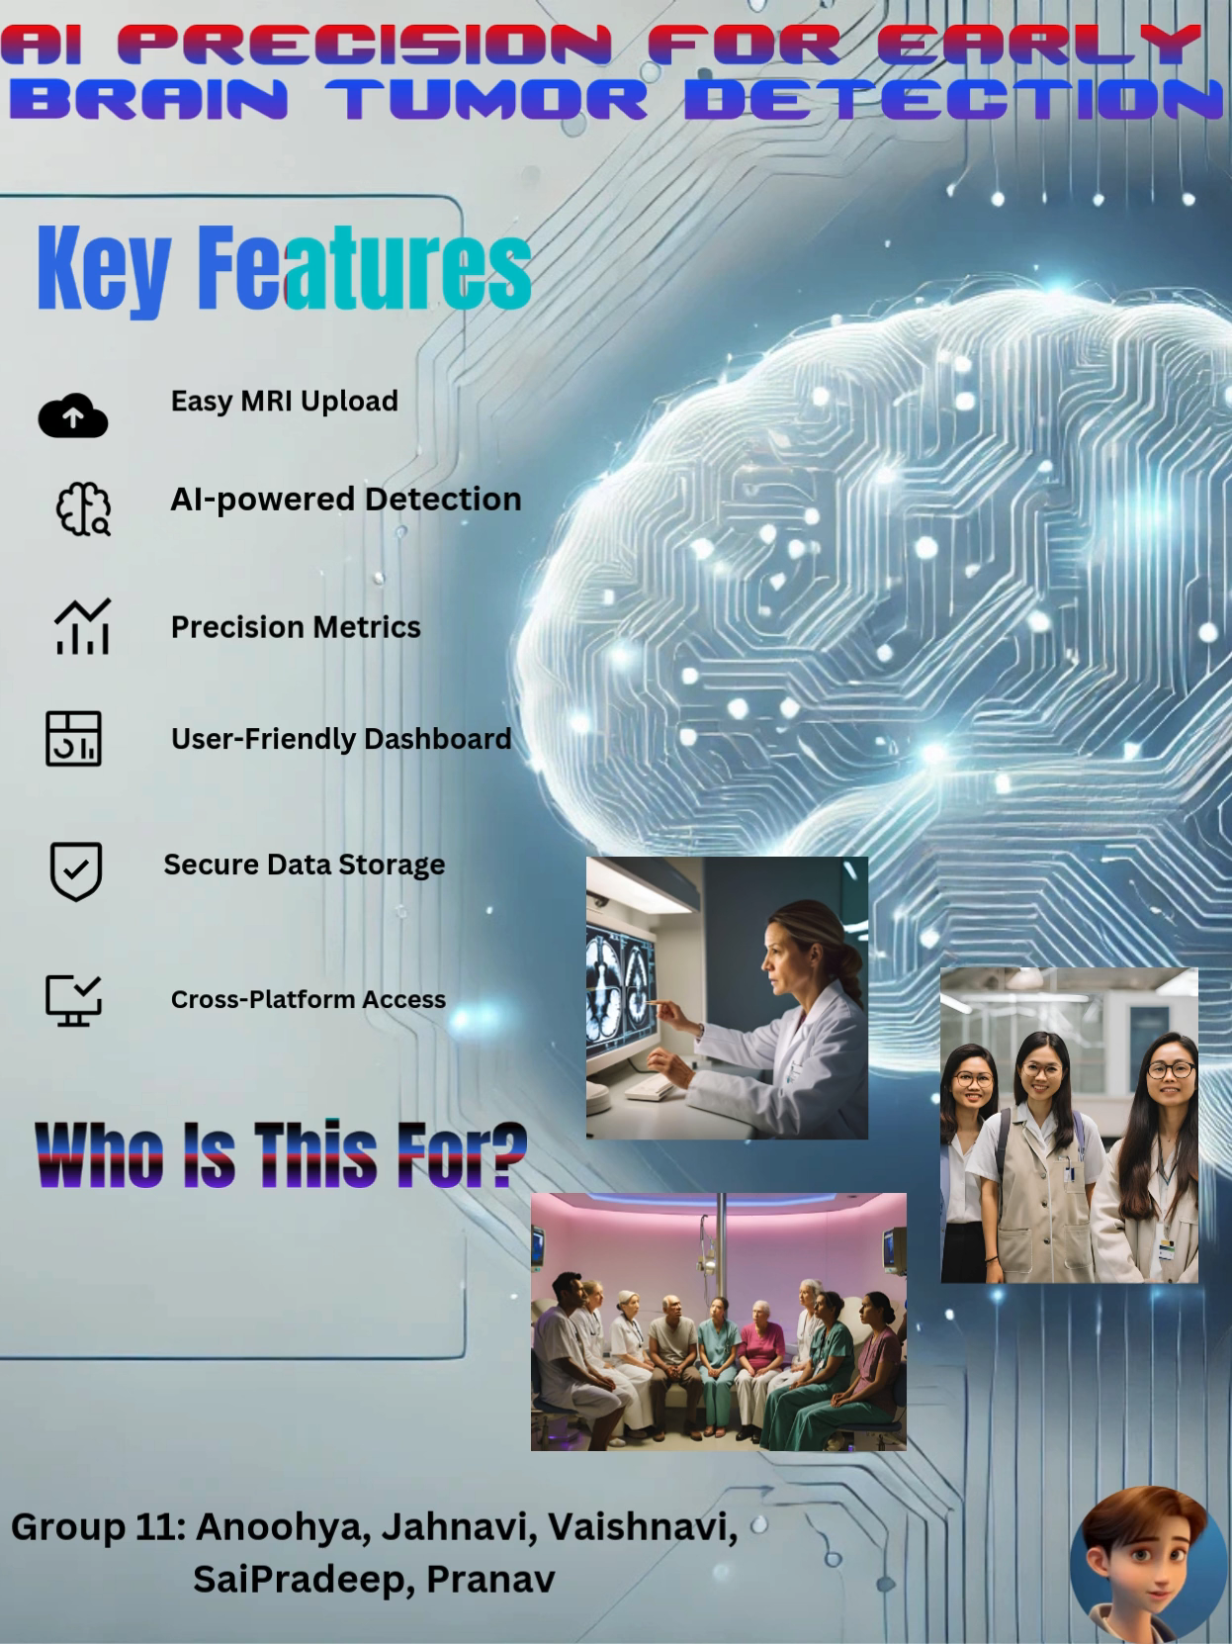
Product Brochure:

Slide 3
Product Overview
Who: Researchers, Medical Professionals, Patients
What: A web platform for uploading MRI scans for brain tumor detection
Purpose: Provide accurate, quick, and accessible tumor diagnosis using machine learning
Notes:
This system empowers three user roles: patients, doctors, and researchers, with tailored dashboards to suit their needs.""For example, patients can upload MRI scans and view results, doctors can manage patients and view detailed reports, and researchers can evaluate algorithms using real-time metrics and visualizations

Slide 4
Actors and Goals
Medical Professional: Upload MRIs, get diagnostic results
Patient: Upload scans for second opinions or initial diagnosis
Researcher: Uploads scans for multiple algorithms evaluation

Slide 5
Project Goals And Objectives
AI-Powered MRI Analysis - Utilizes deep learning algorithms for tumor detection and classification.
Comprehensive Reporting - Generates detailed reports for doctors and researchers.
Multi-role Support - Provides tailored interfaces for patients, doctors, and researchers.
Secure Data Handling - Employs robust security measures to protect patient data.
Notes:
Our project is designed with the following objectives:AI-Powered MRI Analysis to automate tumor detection and classification.
Comprehensive Reporting for medical professionals to make informed decisions.
Multi-role Support to cater to patients, doctors, and researchers.
Secure Data Handling to protect sensitive patient information using robust measures
We combine AI algorithms with a user-friendly interface to make complex tumor detection accessible to everyone

Slide 6
Features Implemented
Multiple patients MRI Reports: Doctor managing
MRI Upload: Support for various formats like PNG, JPEG
Tumor Detection: Analysis using ML models, generating tumor/no tumor result.
Preliminary Diagnosis: Easy interface for patients to get feedback on tumor presence
Notes:
So far, we have implemented the following features:
Uploading and processing MRI scans for patients and researchers.
Running tumor predictions with confidence scores using CNN models.
Providing detailed visualizations for algorithm performance, including confusion matrices and classification reports.
Ensuring secure access to sensitive data using Role-Based Access Control."
Transition to Demonstration:"Now, let’s see these features in action in our live demonstration.

Slide 7
Functional Requirements
Secure Login, MRI Upload, Tumor Detection, Report Generation
Focus on accuracy, security, accessibility, and scalability

Slide 8
Nonfunctional Requirements
High Accuracy: Detection above 90%
Fast Processing: Results within 5 minutes
Data Security: Compliance with Werkzeug, dotnet, axios
Scalability: Handle large data and concurrent requests

Slide 9
Key Component Implementation
Data Input: User uploads MRI scans, batch processing for researchers
Archiving: Database storage with MongoDB and Flask
Analysis: CNN model analysis, precision and accuracy display
Display: User-friendly interface, report generation
Unique Capability: Integrating ML-based analysis directly accessible by users, quick feedback mechanism Secure Data Handling, Employs Role-Based Access Control (RBAC) for secure access.

Slide 10
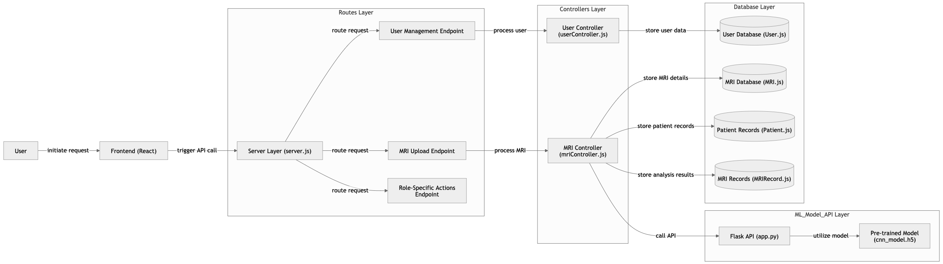
SYSTEM DESIGN ARCHITECTURE:

Slide 11
Tools and technologies
Frontend:
- HTML, CSS, JavaScript for structuring and styling.
- React.js as it’s highly efficient for building interactive user interfaces.
Backend:
- Node.js (using Express) for a fast, non-blocking server environment.
- Python Flask to serve the machine learning model as an API, which provides seamless ML model integration.
- MongoDB for database storage, enabling easy document storage of user data, images, and reports.
ML Integration:
- TensorFlow/Keras in Python for model loading and predictions.
- The ML model API in Flask will connect with the Node.js server via REST API.

Slide 12
Tech Stack Summary
Category | Technology/Tool | Purpose
Frontend | React.js, Bootstrap | User interface and styling
Backend | Flask, Flask-CORS | API and business logic
Database | MongoDB, PyMongo | Storing patient and research data
Machine Learning | TensorFlow/Keras, Scikit-learn | Pre-trained models for predictions
Data Handling | Pandas, OpenCV | Dataset processing and image preprocessing
Utilities | dotenv, Axios, Werkzeug | Configuration, API calls, and file handling
Notes:
"Our tech stack is built with a focus on scalability, efficiency, and seamless integration:React.js for the frontend, ensuring a responsive and interactive UI.
Flask and Node.js for the backend, enabling secure and efficient API communication.
MongoDB for data storage, supporting the seamless handling of patient data and results.
TensorFlow/Keras for deep learning model integration, ensuring accurate tumor predictions.

Slide 13
User Interface Design
Patient Flow: Simple MRI upload and result view
Doctor Flow: Patient management, upload, detailed report view
Researcher Flow: Advanced analysis with multiple algorithms

Slide 14
Use Cases
Case 1: Patient Uploading MRI Scan for Preliminary Analysis
Case 2: Doctor Uploading and Viewing Patient's MRI Analysis
Case 3: MRI Algorithm Evaluation and Comparison
Case 4: Doctor Managing Multiple Patients' MRI Reports

Slide 15
Scenario Demonstration
Scenario 1: Patient uploads an MRI scan and gets preliminary feedback
Scenario 2: Medical Professional uploads a patient's MRI, receives detailed analysis, Multiple Patient Dashboard
Scenario 3:Researcher Page: Enables dataset uploads with success notifications, processing indicators, error handling, result display, and logout functionality.

Slide 16
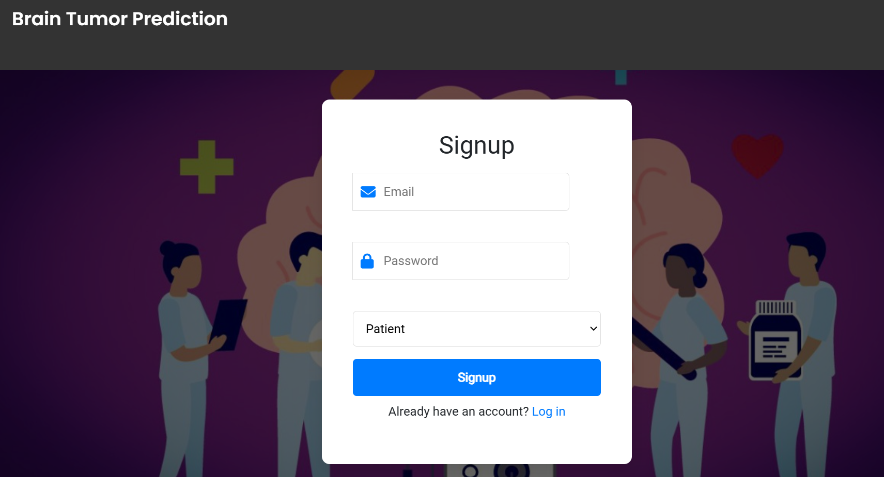
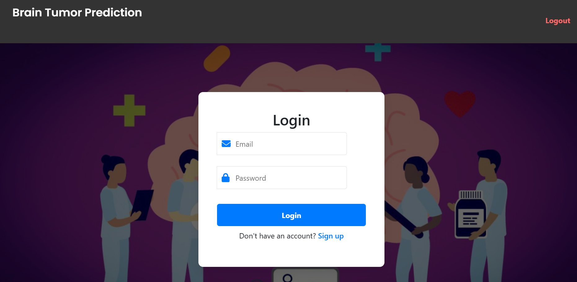
Demonstration Details
Sign Up Page:
Login Page:

Slide 17
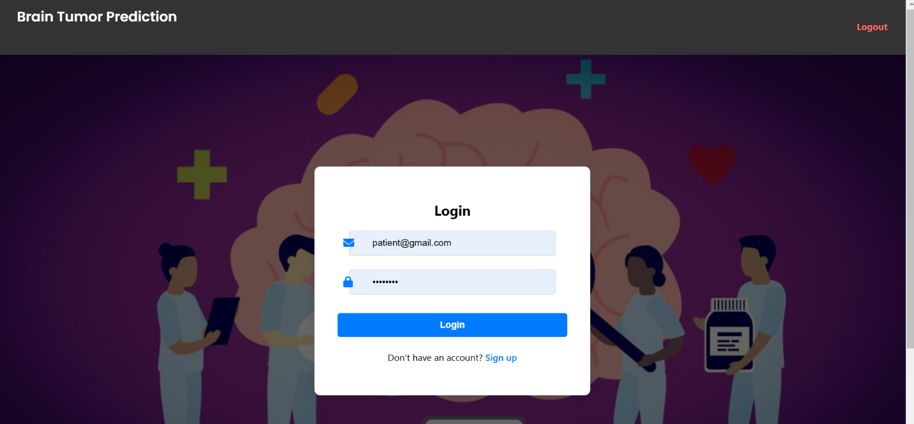
Demonstration Details
For Patients: Login Page
Notes:
Scenario 1: Patient Workflow
Steps to Demonstrate:
"As a patient, I log in and access the dashboard."
"I select an MRI scan from my device, and the system provides a preview."
"Next, I click 'Predict Tumor,' and the model processes the scan, displaying the prediction along with the confidence score. For example, here, the system detects a tumor with a 96.6% confidence."
"If no tumor is detected, a clean report is generated."
Highlight:
"The simplicity of the patient workflow ensures usability while maintaining AI-driven accuracy."

Slide 18
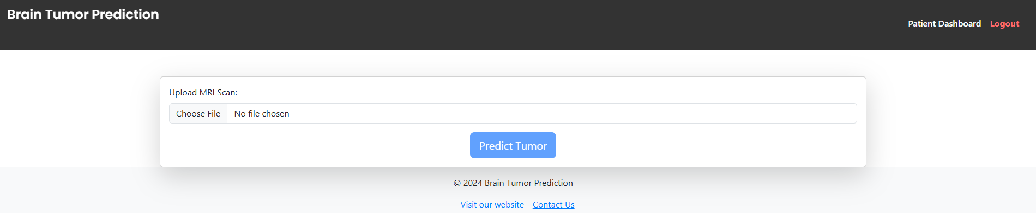
Patient DashBoard:

Slide 19
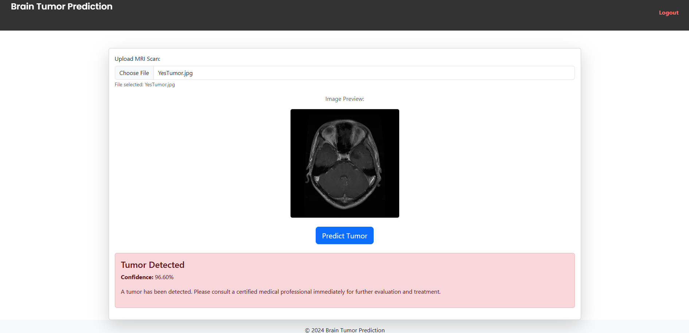
Patient Upload and Mri prediction:
Yes:Tumor

Slide 20
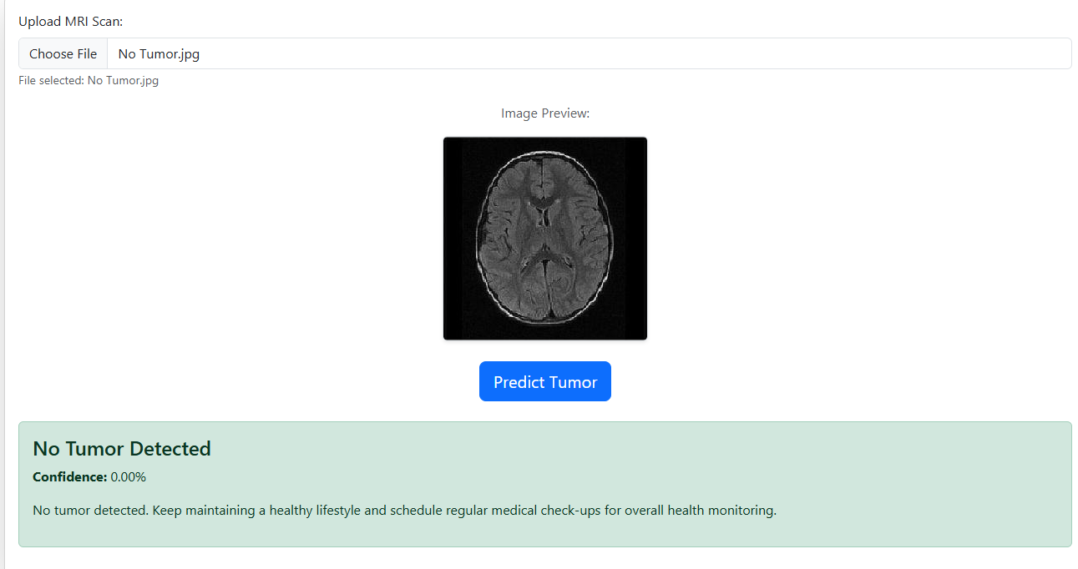
Patient Upload and Mri prediction:
NO:Tumor

Slide 21
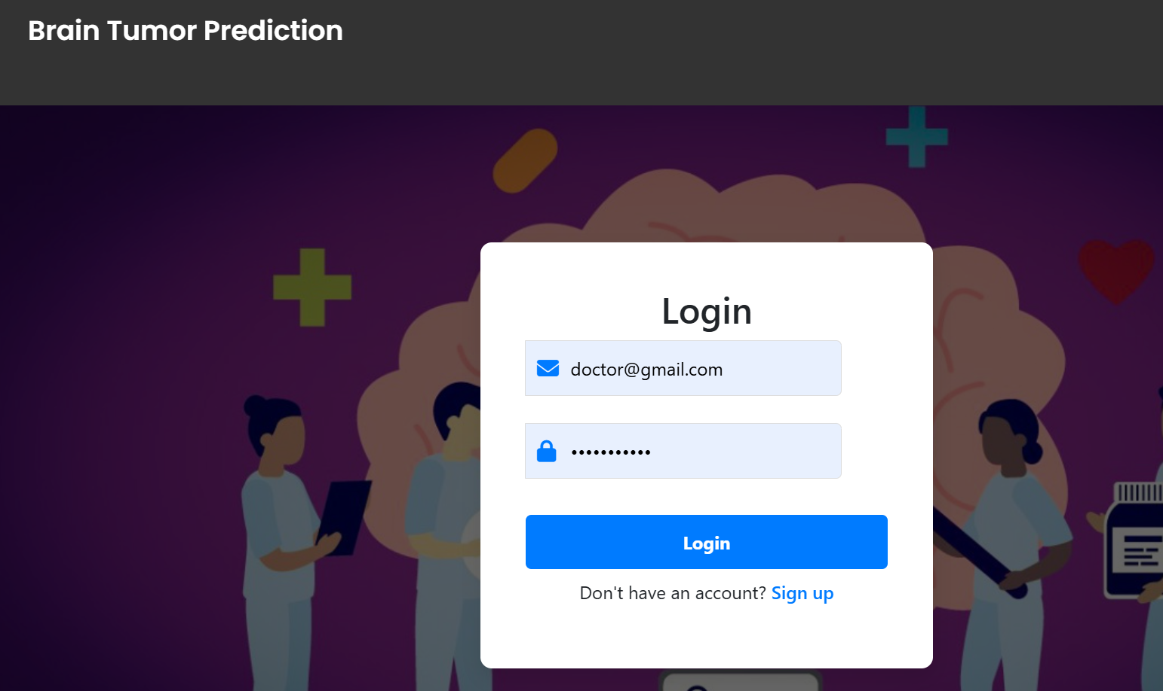
For Doctor: Login Page

Slide 22
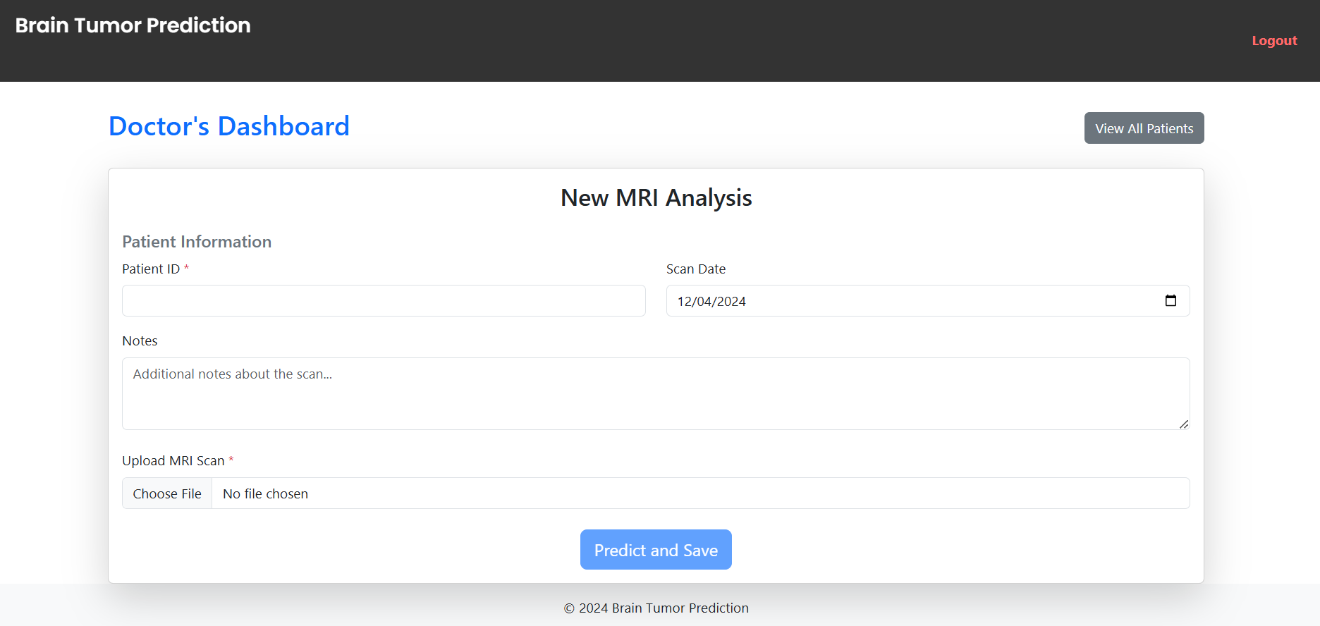
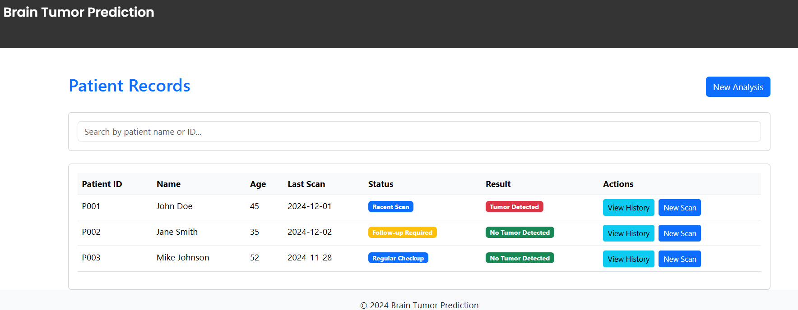
Doctor: Prediction and Patient Dashboard:
Notes:
"Doctors log in to their dashboard, where they can manage multiple patient records."
"They can upload MRI scans, view previous results, and download detailed reports for each patient."
"The longitudinal tracking feature helps doctors monitor tumor progression over time."
Highlight:"This dashboard supports effective patient management and facilitates collaborative care.

Slide 23
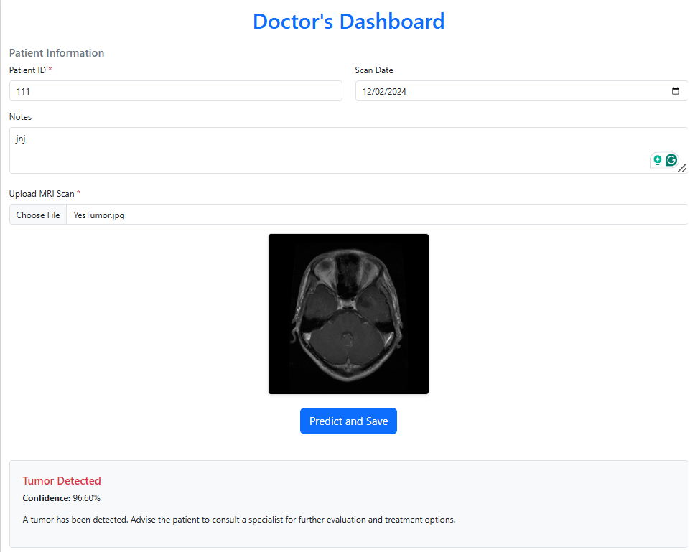
Doctor’s Prediction dashboard:

Slide 24
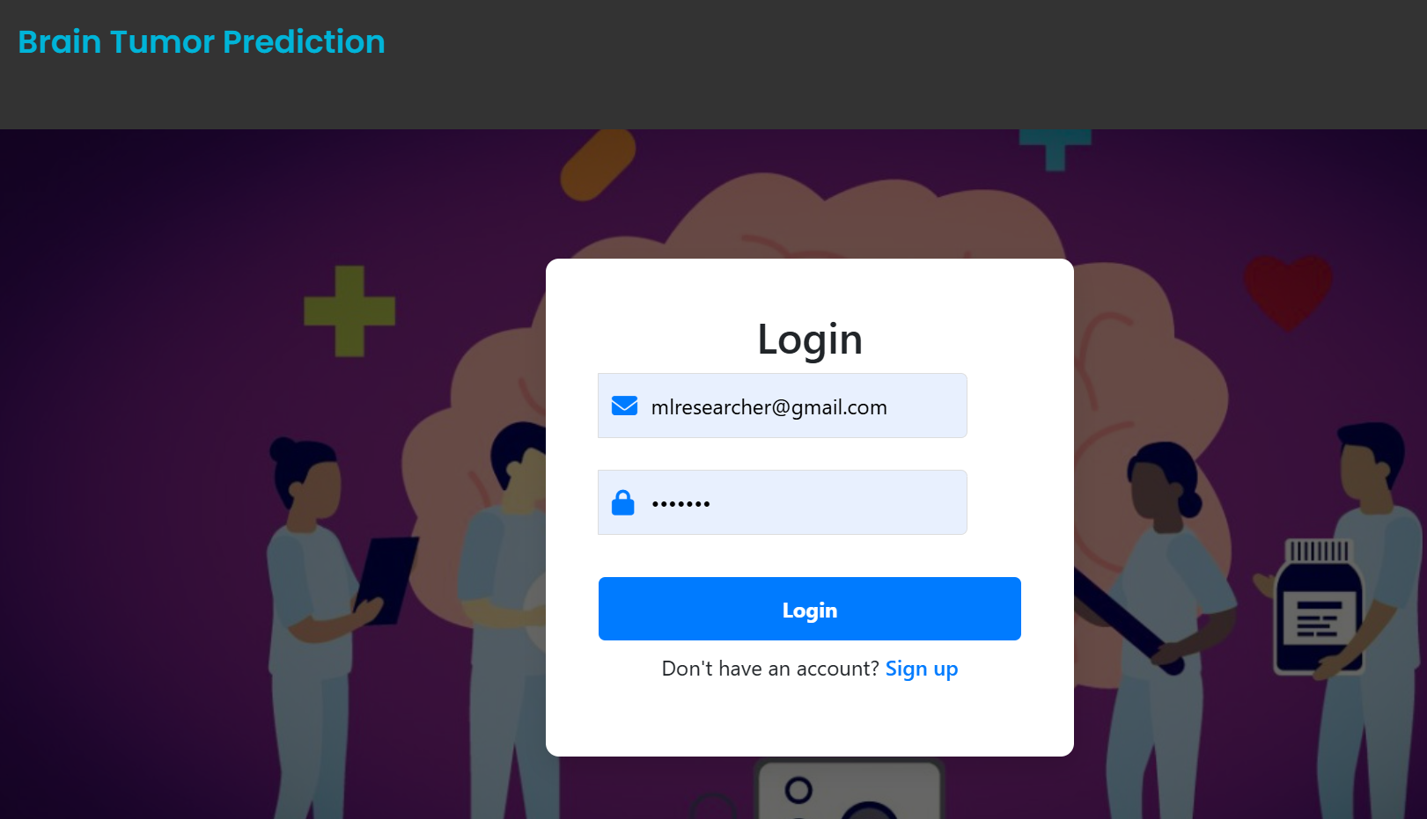
Researcher dashboard:
Notes:
"Researchers log in to the Algorithm Dashboard."
"They can select an algorithm (e.g., CNN or Logistic Regression) and view performance metrics, such as classification reports and confusion matrices."
"Visualizations are dynamically updated to assist in understanding the model's strengths and weaknesses."
Highlight:"The researcher flow is tailored for advanced users who need to evaluate and compare algorithms.

Slide 25
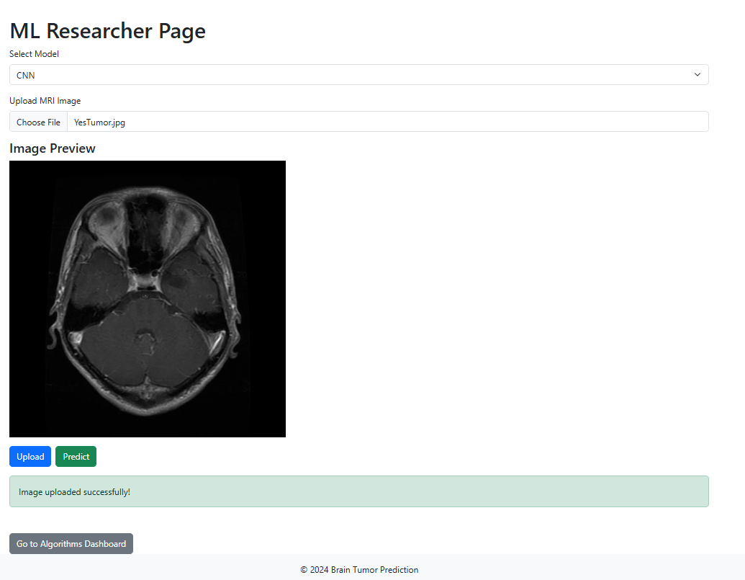
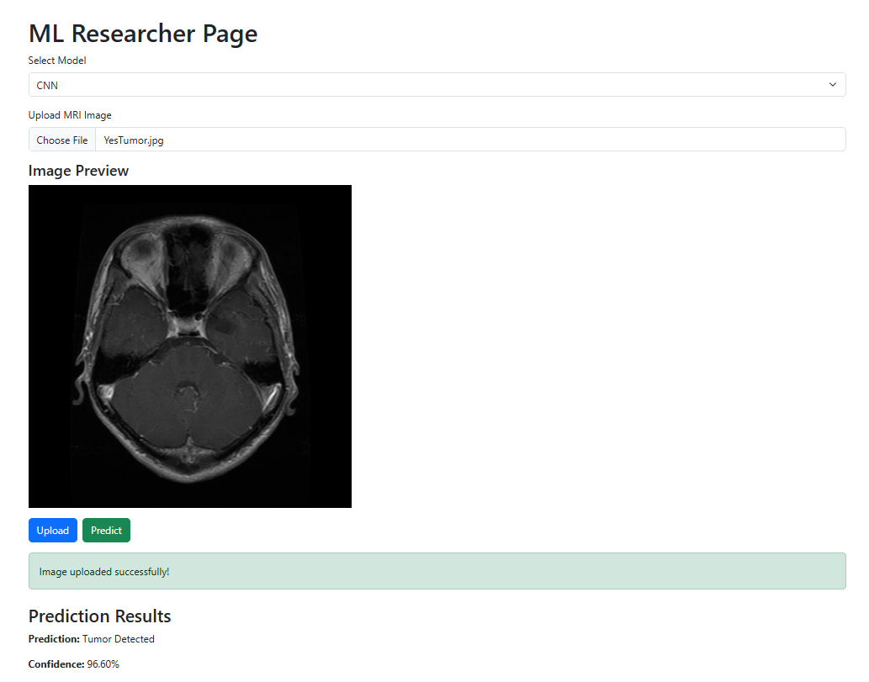
For ML Researcher:

Slide 26
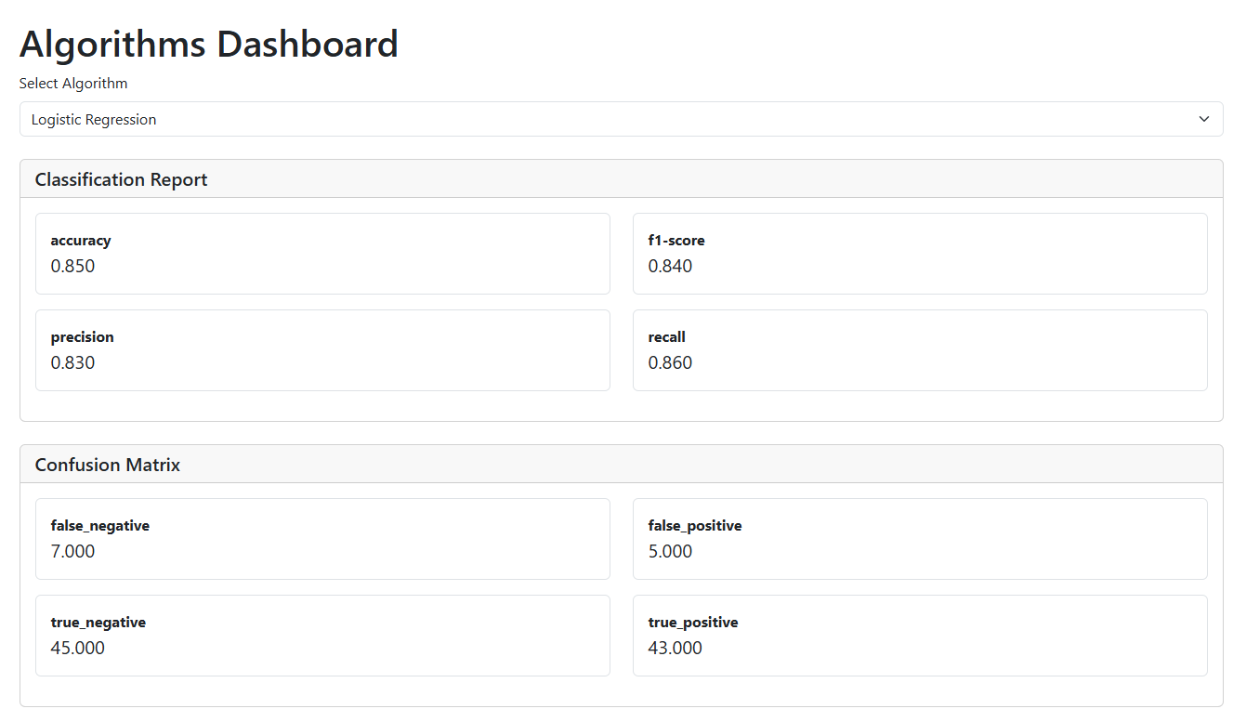
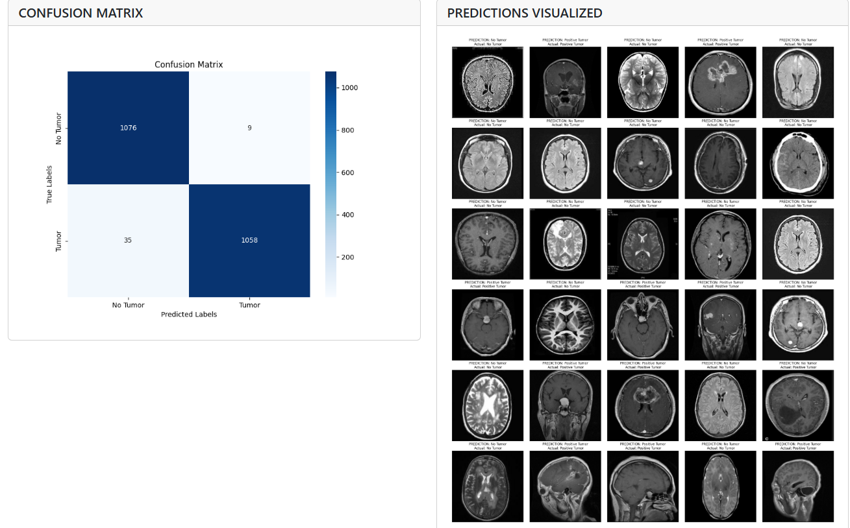
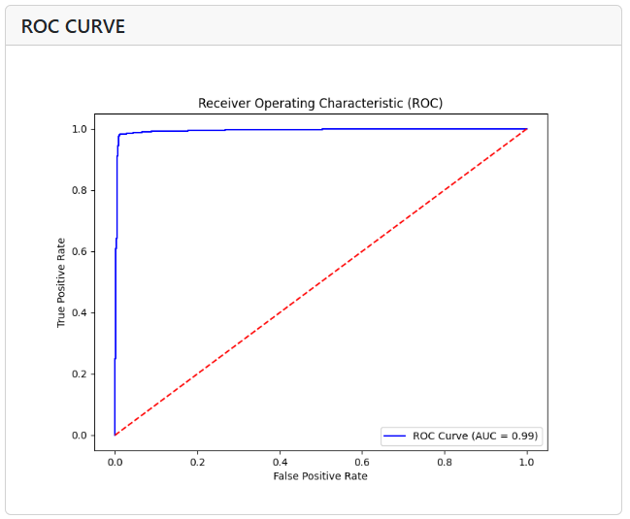
ML Researcher: Algorithm DashBoard:

Slide 27
Website demo

Slide 28
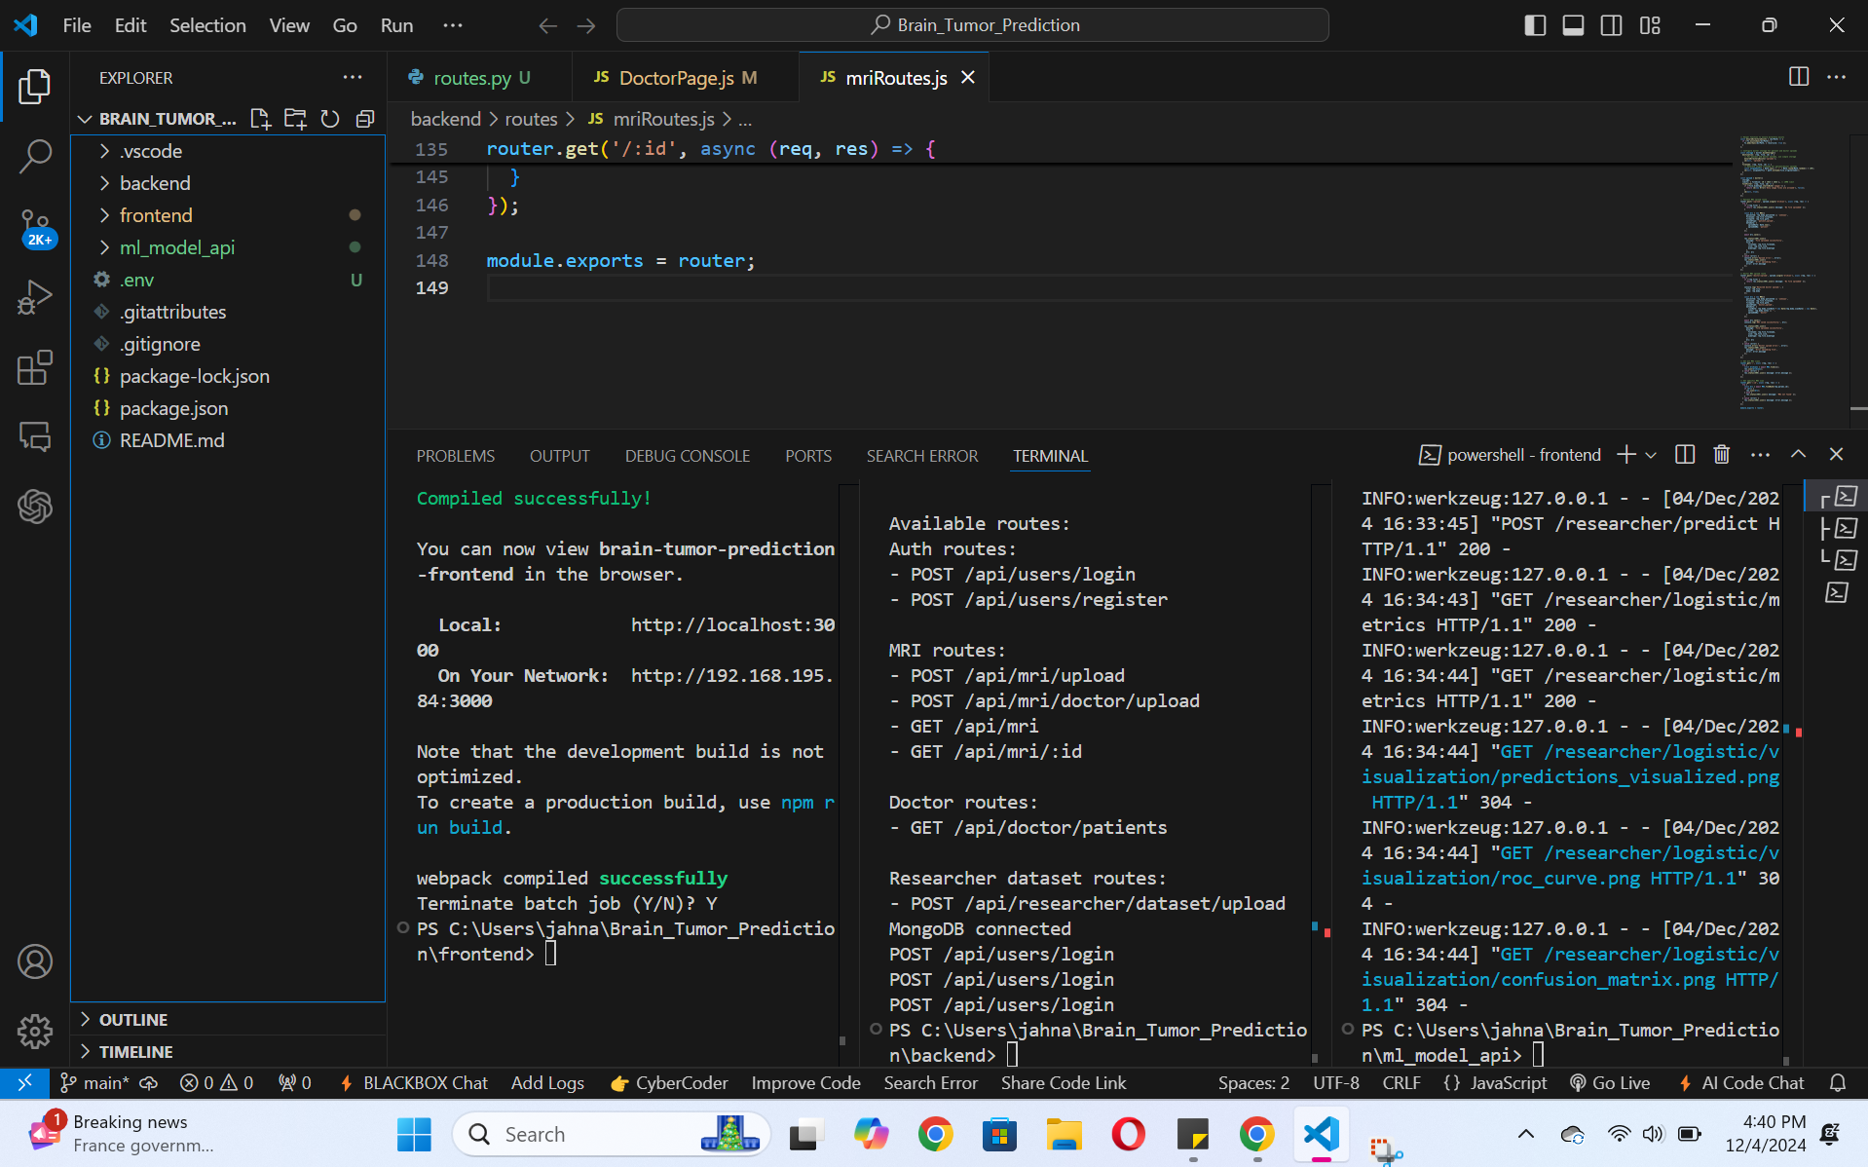
PROJECT SOURCE CODE

Slide 29
KAGGLE demo

Slide 30

Future Plan
Scalability for Large-Scale Deployments
Cloud-based serverless architecture.
Auto-scaling to handle high user volumes.
A Research Collaboration Platform
Shared platform for dataset uploads and model testing.
Repository for peer-reviewed AI models and algorithms.
Advanced Analytics and Predictive Modeling
- Longitudinal tracking of tumor changes.
- AI-driven outcome prediction and monitoring.
Notes:
Looking forward, we aim to scale this system with cloud-based architecture, enabling global accessibility and auto-scaling to handle higher user volumes.""We also plan to introduce a research collaboration platform where users can upload datasets, test new models, and share insights.""Advanced analytics and predictive modeling will help track tumor progression and predict treatment outcomes over time.

Slide 31

Conclusion
Our AI-powered MRI analysis system offers accuracy, accessibility, and security for brain tumor detection. We're committed to pushing the boundaries of medical diagnosis, empowering doctors and researchers, and improving patient outcomes. Join us in revolutionizing healthcare with AI!
Notes:
In conclusion, our AI-powered MRI analysis system combines precision, accessibility, and security to revolutionize brain tumor detection.""By empowering doctors, researchers, and patients, this project aims to push the boundaries of medical diagnostics and improve outcomes for those affected by brain tumors.""Thank you for your attention, and we are happy to answer any questions you may have."

Slide 32

Thank You!

